Slide 1

AI Automated Trading System
By: Ahmed Sherif Mohamed Sabry
ID: 21512145
Supervisor: Prof. Mahmoud Atallah

Slide 2
Agenda
Problem Statement
Related Work and Proposed Project Comparison
Proposed Solution
Use case Diagrams
Activity Diagrams
Time Plan "Gant Chart"
References
Sequence Diagram

Slide 3
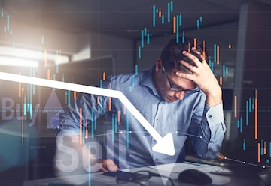
Problem Statement
Trading in financial markets is challenging due to rapid price changes and large amounts of data that need to be analyzed quickly. Human traders may struggle to keep up, leading to delays, mistakes, or emotional decisions.

Slide 4
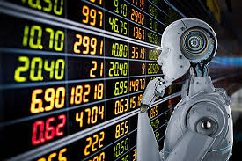
Proposed Solution
Developing an automated trading system that uses machine learning to analyze historical market data and predict stock price movements. The system will generate buy/sell signals to support the trader, while the final decision remains with the human user “Human-in-the-Loop Design”.
The goal is to improve trading speed and accuracy while reducing emotional and rushed decisions.
The system's user-friendly design ensures that both novice and experienced traders can benefit from its features.

Slide 5
Related Work vs Proposed Project Comparison
Feature | Automated Trading System | Hybrid AI Trading Strategies | Stock Price Prediction | Proposed System
Main Focus | Full automation of trading decisions | Improving prediction using multiple models | Predicting stock prices using LSTM | Prediction + Human-approved trading
ML Techniques Used | Not specified | Random Forest, SVM | LSTM | LSTM + Random Forest
Trader Control | Fully automated, no user control | Limited (no interface for control) | No trader involvement | User approves trades manually
Decision Execution | Fully automated | No trade execution | No execution | Generates signals; trader approves
Target Users | Advanced traders | Experienced users | Researchers / Analysts | Both beginners and experts
Limitation Summary | Lacks human judgment, trust issues | Complex, lacks interactive features | No decision support or interface | Relies on past data, possible human bias
Key Advantage Over Others | Speed and full automation | Smarter strategies with hybrid models | High accuracy in price prediction | Combines speed + control + usability
Accuracy / Performance | Not specified (focus on execution) | 92.8% | 94.2% | Estimated 93–95% (based on LSTM+RF)
Year | 2019 | 2021 | 2023 | 2025 (Proposed)

Slide 6
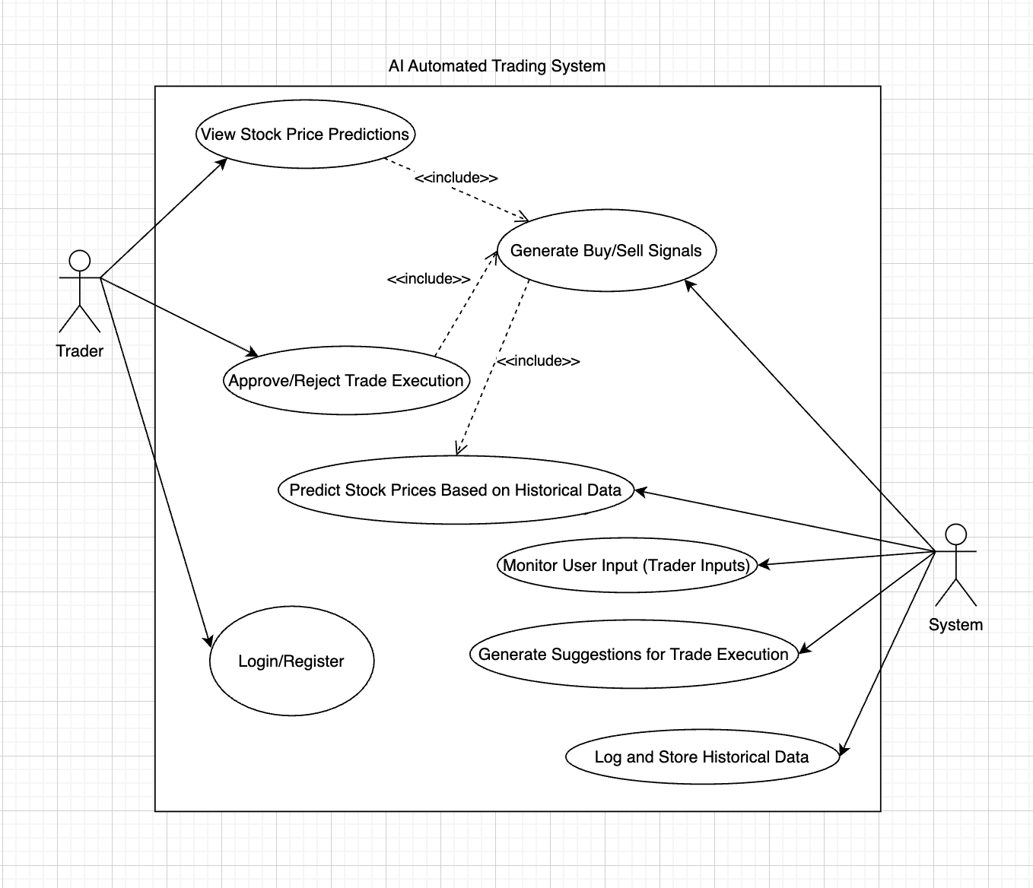
Use case Diagram

Slide 7
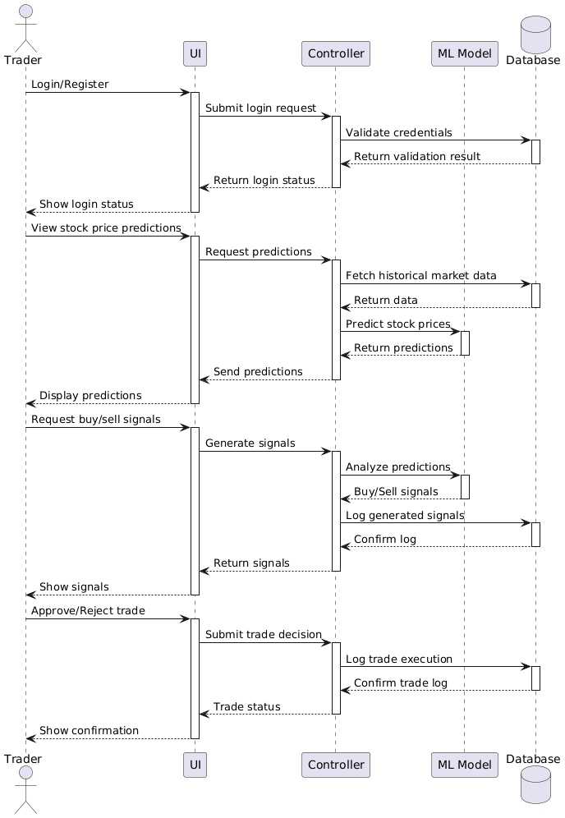
Sequence Diagram

Slide 8
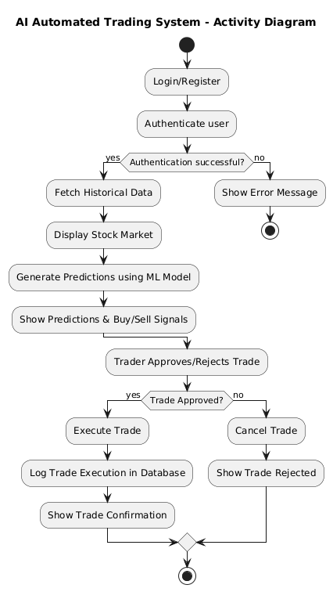
Activity Diagram

Slide 9
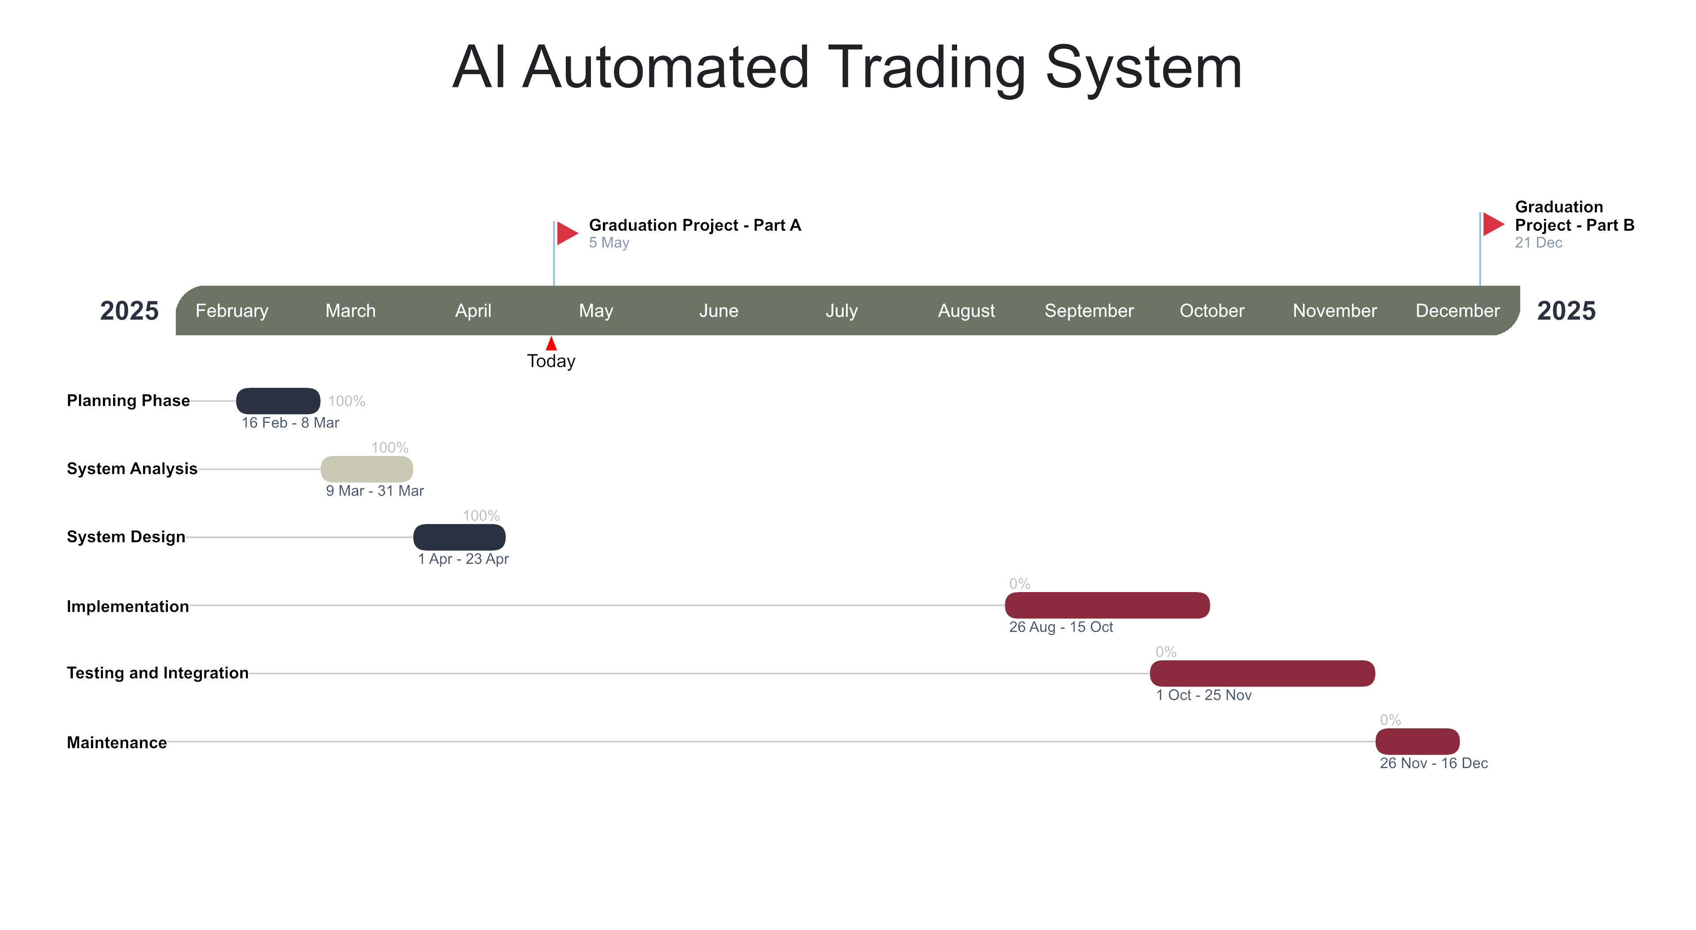
Project Time plan “Gant Chart”

Slide 10
References
[1] Li, Z., Yu, H., Xu, J., Liu, J., & Mo, Y., 2023. Stock Market Analysis and Prediction Using LSTM: A Case Study on Technology Stocks. Innovations in Applied Engineering and Technology, 2(1), pp.1-6. https://doi.org/10.62836/iaet.v2i1.162.
[2] Moghar, A. & Hamiche, M., 2020. Stock Market Prediction Using LSTM Recurrent Neural Network. Procedia Computer Science, 176, pp.2766-2775. https://doi.org/10.1016/j.procs.2020.09.319.
[3] Mendoza, L. & Zhang, M., 2019. Design of an Automated Stock Trading System Using Artificial Intelligence. International Journal of Financial Engineering, [online] Available at: https://www.tandfonline.com [Accessed 5 May 2025].
[4] Liu, J., et al., 2021. AI-Based Hybrid Stock Trading System Using Random Forest and Support Vector Machines. Financial Innovation, [online] Available at: https://link.springer.com/article/10.1186/s40854-021-00288-1 [Accessed 5 May 2025].
[5] Python Official Website. (n.d.). Python.org. Available at: https://www.python.org/ [Accessed 5 May 2025].
[6] Scikit-learn Machine Learning Library. (n.d.). Scikit-learn. Available at: https://scikit-learn.org/ [Accessed 5 May 2025].
[7] Investopedia. (n.d.). AI in Trading. Available at: https://www.investopedia.com/ [Accessed 5 May 2025].
[8] Medium. (n.d.). Articles about AI Trading (general reading). Available at: https://medium.com/ [Accessed 5 May 2025].
[9] Yahoo Finance and Kaggle. (n.d.). Example Datasets. Available at: https://www.yahoo.com/finance and https://www.kaggle.com/ [Accessed 5 May 2025].
[10] PlantUML. (n.d.). PlantUML. Available at: https://plantuml.com/ [Accessed 5 May 2025].
[11] draw.io. (n.d.). draw.io (diagrams.net). Available at: https://app.diagrams.net/ [Accessed 5 May 2025].

Slide 11
Thank You

